Slide 1

HON. A.Z DIGITAL FELLOWSHIP
POWER BI
FUNDAMENTALS & POWER QUERY
INTRODUCTION TO POWER BI
AMINU MUHAMMED B.
DATA ENTHUSIAST

Slide 2



HON. A.Z DIGITAL FELLOWSHIP
AGENDA
Introduction to Business Intelligence
Uses, Applications & Importance
Opportunities & Demand
Data Formats
Creating Dashboards & visualizations

Slide 3
HON. A.Z DIGITAL FELLOWSHIP
Components
What is Business Intellingence
Business Intelligence is the process of using specific Software/Applications to transform raw data into actionable insights.
BI = turning raw data Actionable insights
Helps decision making
Tracks performance
Forcasts trends
Uses of Power BI
Reporting and Dashboards
Data modelling & Transformation
Real-time monitoring
Predictive analytics

Slide 4

HON. A.Z DIGITAL FELLOWSHIP
WHAT IS POWER-BI
Microsoft Power BI is a collection of apps, software services and connectors that
come together to turn unrelated data into visually impressive and interactive
insights. Power
BI has the capabilities to easily connect to your data sources, visualize and share
and publish your findings with anyone and everyone.
Power BI is simple and fast enough to connect to an Excel workbook or a
local database. It can also be robust and enterprise-grade, ready for extensive
modeling and real time analytics. This means it can be used in a variety of
environments from a personal report and visualisation tool to the analytics and
decision engine behind group projects, divisions, or entire corporations.

Slide 5
HON. A.Z DIGITAL FELLOWSHIP
APPLICATIONS ACROSS INDUSTRIES
FINANCE: Budgeting & Forecasting
HEALTHCARE: Diseases Mapping & Incidence Tracking
RETAIL: Sales Optimization
Government: Policy Making & Informed Decisions

Slide 6
HON. A.Z DIGITAL FELLOWSHIP
OPPORTUNITIES AND DEMAND
In-Demand roles:
-Data Analyst
-BI Analyst
-Power BI Developer
-Consulting Opportunities
-Product Analyst
-Public Health Analyst

Slide 7
HON. A.Z DIGITAL FELLOWSHIP
Building Blocks of Power-BI
The basic building blocks in Power BI are:
• Visualizations
• Datasets
• Reports
• Dashboards
• Tiles

Slide 8
HON. A.Z DIGITAL FELLOWSHIP
1. Visualizations
A visualization is a representation of data in a visual format. It could be a line
chart, a bar graph, a color coded map or any visual way to present the data.
Visualizations can be a simple number representing a significant calculation or
it could be more complex like multiple charts showing the proportion of users
participating in a survey. The main idea of visualization is to show the data in
a way that tells the story that is lying underneath it. Like the saying goes: a
picture says a thousand words.

Slide 9
HON. A.Z DIGITAL FELLOWSHIP
Datasets
A dataset is a collection of data that Power BI uses to create its visualizations.
You can have a simple dataset that’s based on a single table from An Excel workbook, similar to what’s shown in the image.

Slide 10
HON. A.Z DIGITAL FELLOWSHIP
DATA/FILE FORMATS
Text & Document formats
Txt: plain text, no formatting
Doc/docx: Microsoft word documents
Pdf: portable document format
Rtf: rich text format
Md: markdown
2. Data Storage & Exchange Format
CSV: Comma Separated values
TSV: Tab Separated Values
JSON: Java Script Object Notation
3. Spreadsheets & Visualization formats
XLS/XLSX: Microsoft Excel spreadsheet
ODS: OpenDocunment Spreadsheets
PBIX: PowerBI file extension in graphics format
4. Structured data formats
SQL dumps (.sql): Database export files
MDB: Microsoft Access Databases
DB: lightweight database file

Slide 11
HON. A.Z DIGITAL FELLOWSHIP
Reports
In Power BI, a Report is a collection of visualizations that appear together on
one or more pages. A report in Power BI is a collection of items that are related
to each other.

Slide 12
HON. A.Z DIGITAL FELLOWSHIP
Dashboards
A Power BI dashboard is a collection of visuals from a single page that you
can share with others. Often it is a selected group of visuals that provide quick
insight into the data or story you are trying to present.
A dashboard must fit on a single page, often called a canvas (the canvas is the
blank backdrop in Power BI Desktop or the service, where you put visualizations).
Think of it like the canvas that an artist or painter uses — a workspace where
you create, combine, and rework interesting and compelling visuals. You can
share dashboards with other users or groups, who can then interact with your
dashboards when they’re in the Power BI service or on their mobile device.

Slide 13
HON. A.Z DIGITAL FELLOWSHIP
Overview of the User Interface
1. Ribbon - Displays common tasks that are associated with reports and
visualizations.
2. Report view, or canvas - Where visualizations are created and arranged.
3. Pages tab - this area is where you
would select or add a report page.
4. Visualizations pane - Where you can change visualizations, customize
colors or axes, apply filters, drag fields, and more.
5. Fields pane - Where query elements and filters can be dragged onto the Report view.

Slide 14
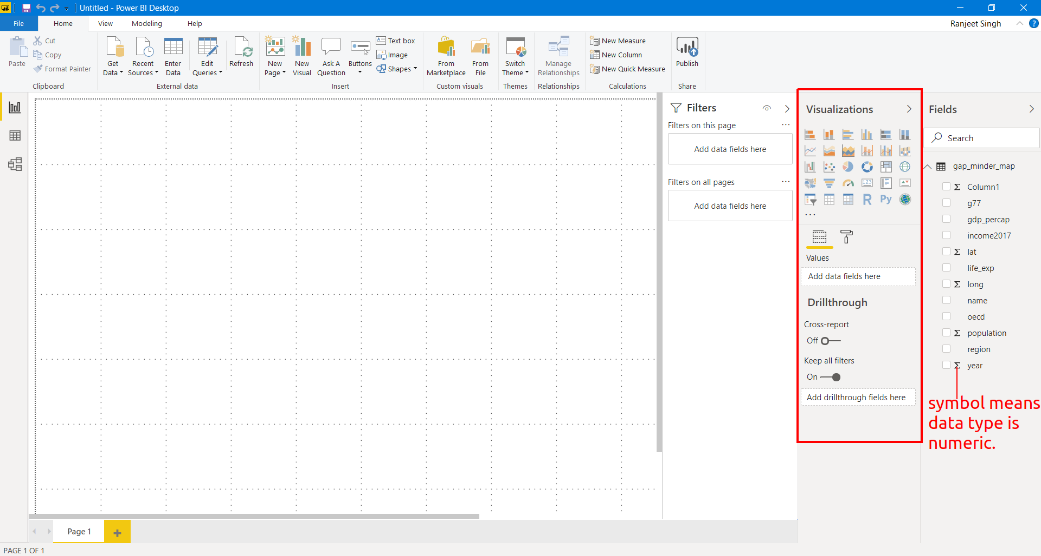
HON. A.Z DIGITAL FELLOWSHIP
PLOTTING
One of the panels is the Visualization panel highlighted in the Red
box. It contains various types of charts that you can create to visualize your
data. Some of the available chart types are - Stacked bar chart, Line chart, Area
chart, Scatter plot, Pie chart, etc.

Slide 15
HON. A.Z DIGITAL FELLOWSHIP
Saving and Exporting
Saving as pbix files
Go to File > Save, then choose an appropriate file name and the folder to save
it. Click on Save.

Slide 16
HON. A.Z DIGITAL FELLOWSHIP
Exporting & Publishing
Now we want to create a report of our analysis and share it with others. We use
Power BI to publish the report on the Power BI server.
To do this, go to File > Publish > Publish to Power BI

Slide 17
HON. A.Z DIGITAL FELLOWSHIP
Saving and Exporting
Saving as pbix files
Go to File > Save, then choose an appropriate file name and the folder to save
it. Click on Save.

